Slide 1
Conditionals
Hy-Tech Club: Web 102

Slide 2
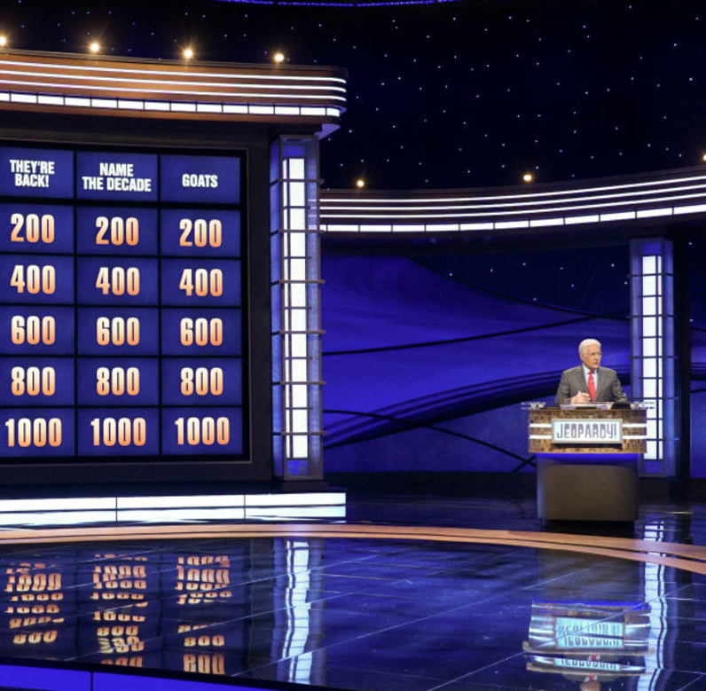
Warm-up Trivia

Slide 3
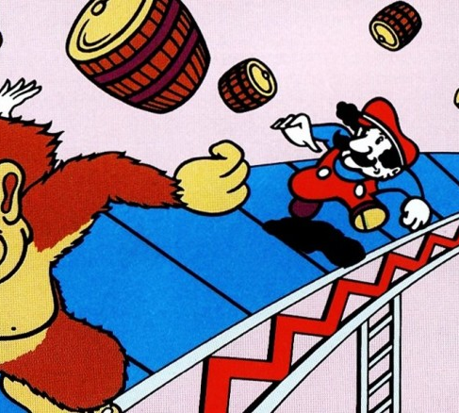

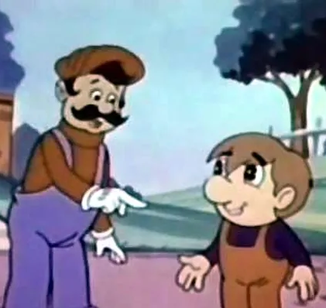

True or False
The capital of Ohio is Columbus
True – but it should be Cleveland
Mario’s original name was Mr. Game
False
It was Mr. Video (then Jumpman)
Notes:
Have students vote on if they think these statements are true or false.

Slide 4

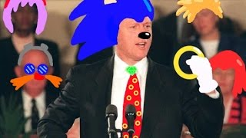
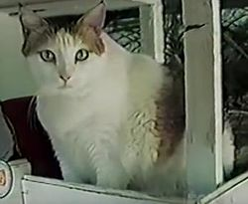
True or False
The oldest domestic cat on record lived for 38 years
True – her name was Crème Puff and she lived in Austin, TX
Sonic the Hedgehog’s personality is based on Bill Clinton
True – the developers wanted him to be “cool”
Notes:
Have students vote on if they think these statements are true or false.

Slide 5
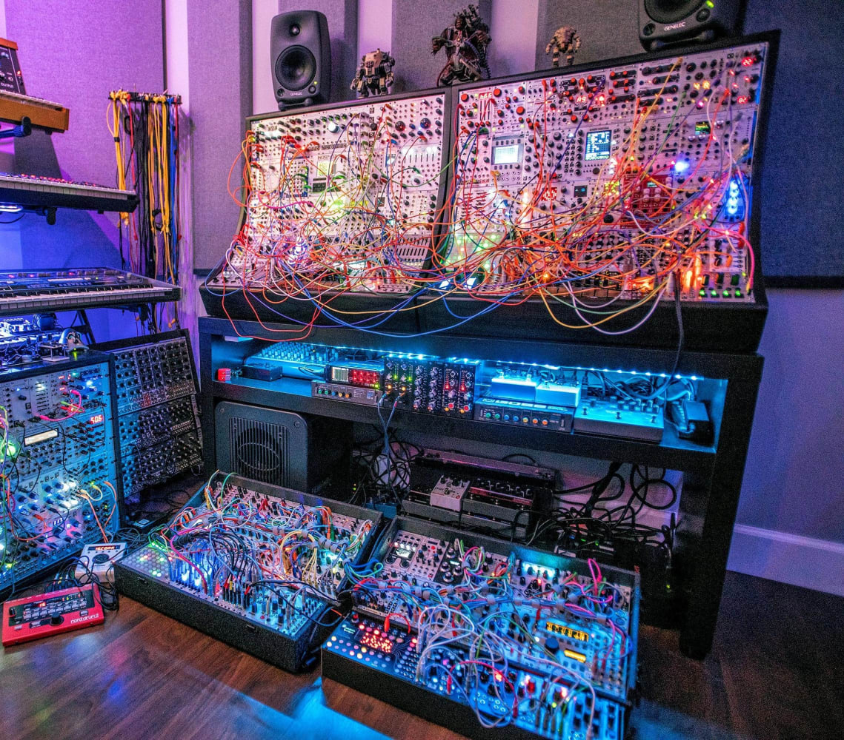
Data Types Review+New

Slide 6
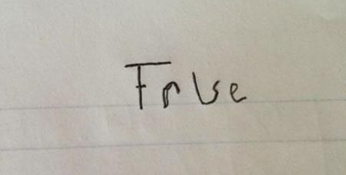
Data types
Number (any number)
let x = 8;
String (any block of text)
let x = "Apple";
Boolean (can only be true or false… no quotes)
let x = true;
let x = false;
Notes:
Ask the students to name the two data types we have seen so far (numbers and strings)
Ask the students to give examples of numbers
Ask the students to give examples of strings
Ask students if they can guess what type of data a boolean is.
Introduce a new data type: Boolean. A Boolean is a data type where values can be either true or false. A boolean is like the answer to a yes/no question. It’s either going to be yes, or no.

Slide 7
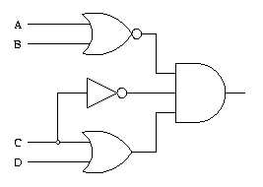
Boolean Expressions
A boolean expression will always evaluate to either true or false
Boolean expressions can be used to control program flow
Examples:
5 > 5 (false)
5 <= 6 (true)
"Hi" === "hi" (false)
7 === 7 (true)
2 === x + 1 (depends on x)
7 != x (depends on x)
Notes:
Explain that Booleans aren’t usually just the literal “true/false” and can be built from other values. This is especially useful if there is a variable within the boolean expression.
The image on this slide is an example of a circuit that uses boolean logic.

Slide 8
THE && Operator
It is possible to combine multiple boolean expressions with && (AND)
Examples:
true && true
true && false
1 > 0 && 1 < 2
5 != 5 && 3 === 4
name1 === "Jim" && name2 === "Jane"
A | B | A && B
true | true | true
true | false | false
false | true | false
false | false | false
true
false
true
false
Depends!

Slide 9
Comparing values for boolean expressions
There are several ways to build boolean expressions, including:
<= less than or equal to
< less than
>= greater than or equal to
> greater than
=== equal to (triple equals sign for equality)
!== not equal to
By making these comparisons, it is possible to change paths through the code with conditionals!
Notes:
Show the basic ways to compare data. Introduce the idea of conditionals.

Slide 10
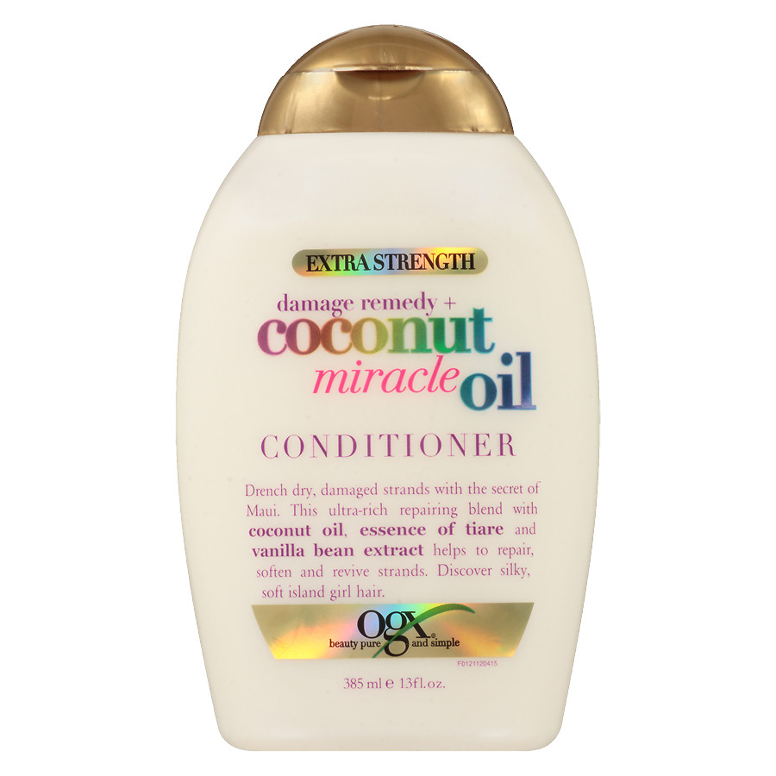
Conditionals
Notes:
This doesn’t actually have anything to do with moisturizing hair

Slide 11
if statements
if (myBalance < 5) {
alert("You do not have enough money!");
}
This code evaluates a boolean expression and executes the code in the body if the boolean is true
if, parentheses, boolean expression, curly brackets, body
Notes:
Ask the students what will happen based on the value of the myBalance variable. For example, what if the myBalance variable was set to 2?
Explain what an if statement does. Note each part of the if statement syntax: if, parentheses, boolean expression, curly brackets, body. Be sure to note where each part appears in the if statement.

Slide 12
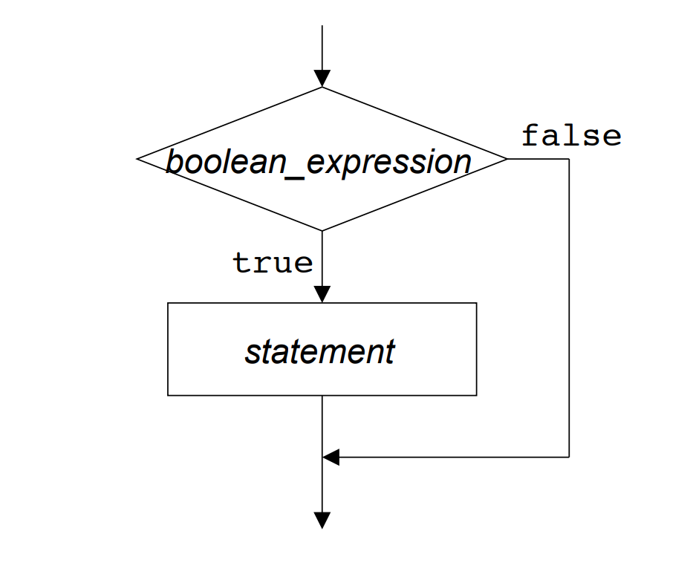
if statements – flowchart
Notes:
This image helps visualize the if statement process.
The execution of the code will reach the if statement, and it will check the value of the boolean_expression. If it is true, it will execute the statement from the body of the if statement. If it is false, it will skip the execution of the statement and move on.

Slide 13
The else clause
if (myBalance < 5) {
alert("You do not have enough money!");
} else {
alert("You have enough money!");
}
If the boolean is evaluated to false, the code in the else will run
No additional boolean is required – just else, curly brackets, body
Notes:
Show the syntax of an else statement and explain that the code in the body of the else will run if the boolean condition is false

Slide 14
else if
if (time < 10) { alert("Good morning"); } else if (time < 20) { alert("Good day"); } else { alert("Good evening"); }
Notes:
Show the syntax of an else if and explain that the code in the body of the else if will run if the first condition is false, but the second is true

Slide 15
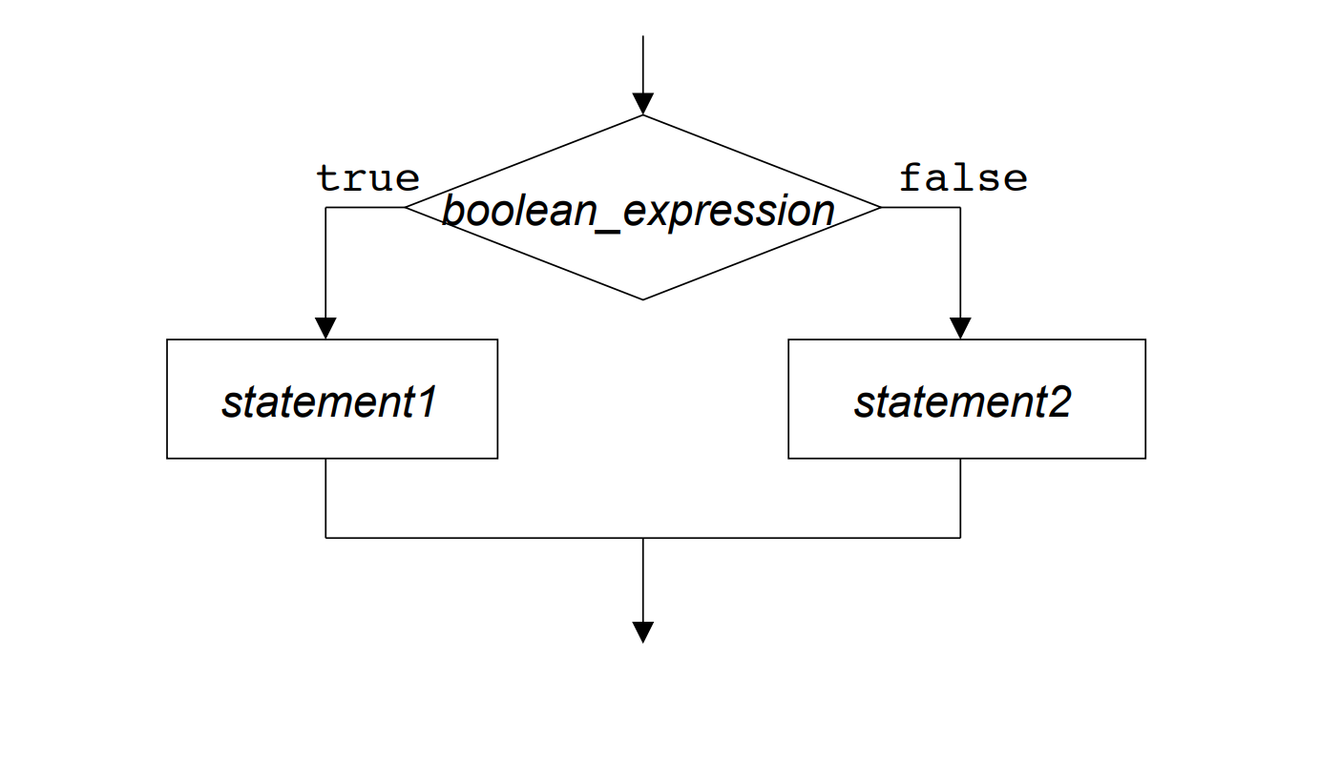
The else clause – flowchart
Notes:
This image helps visualize the else clause process.
The execution of the code will reach the if statement, and it will check the value of the boolean_expression. If it is true, it will execute statement1 from the body of the if statement. If it is false, it will execute statement2 from the body of the else clause. Then, either way, it will move on.

Slide 16
conditional example
https://jsfiddle.net/sr9cp1v2/
Notes:
For the Repl, note how the if statement and else clause work. Change around the values, and setup the prompt as well. Possibly add some new code to see how it can affect the outcome.

Slide 17
TIP: Read it like English
if (myBalance < 5) {
alert("You do not have enough money!");
} else {
alert("You have enough money!");
}
Try translating the code into an English sentence
Notes:
Ask the students to try and think of the code as English. For example: If my balance is less than five, say “You do not have enough money!” Otherwise, say “You have enough money!”

Slide 18

Mini-Quiz Time
????????????????????????????????????????????????????????????????????????????????????????????????????????????????????????????????????????????????????????????????????????????????????????????????????????????????????????????????????????????????

Slide 19
Mini-quiz: What’s the value?
5 > 5
Notes:
For this section, go around the room and ask the students to answer the questions
false

Slide 20
Mini-quiz: What’s the value?
"Hi" === "Hi"
Notes:
true

Slide 21
Mini-quiz: What’s the value?
"Apples" === "Oranges"
Notes:
false

Slide 22
Mini-quiz: What’s the value?
let myBalance = 5;
myBalance + 2 > 6;
Notes:
true

Slide 23
Mini-quiz: what message will be shown?
let myBalance = 5;
myBalance = myBalance + 9;
if (myBalance < 14) {
alert("myBalance is less than 14");
} else {
alert("myBalance is 14 or more!");
}
Notes:
“myBalance is 14 or more!”

Slide 24
Questions?

